Slide 1
Classification and Prediction ——K-Nearest Neighbour——
徐华
清华大学 计算机系 智能技术与系统国家重点实验室
xuhua@tsinghua.edu.cn

Slide 2
Classification and Prediction
Basic Concepts
Issues Regarding Classification and Prediction
Decision Tree
Bayesian Classification
Neural Networks
Support Vector Machines (SVM)
K-Nearest Neighbor
Associative classification
Classification Accuracy

Slide 3
Nearest Neighbor Classifiers
Basic idea:
If it walks like a duck, quacks like a duck, then it’s probably a duck
Compute Distance
Test Record
Training Records
Choose k of the “nearest” records

Slide 4
Nearest Neighbor Classifiers
Requires the following:
A set of labeled records
Proximity metric to compute distance/similarity between a pair of records
e.g., Euclidean distance
The value of k, the number of nearest neighbors to retrieve
A method for using class labels of K nearest neighbors to determine the class label of unknown record (e.g., by taking majority vote)

Slide 5

How to Determine the class label of a Test Sample?
Take the majority vote of class labels among the k-nearest neighbors
Weight the vote according to distance
weight factor, $w = 1/d2$

Slide 6
Choice of proximity measure matters
For documents, cosine is better than correlation or Euclidean
Cosine Distance
1 1 1 1 1 1 1 1 1 1 1 0
0 0 0 0 0 0 0 0 0 0 0 1
vs
0 1 1 1 1 1 1 1 1 1 1 1
1 0 0 0 0 0 0 0 0 0 0 0
Euclidean distance = 1.4142 for both pairs, but the cosine similarity measure has different values for these pairs.

Slide 7
Nearest Neighbor Classifiers
Data preprocessing is often required
Attributes may have to be scaled to prevent distance measures from being dominated by one of the attributes
Example:
height of a person may vary from 1.5m to 1.8m
weight of a person may vary from 90lb to 300lb
income of a person may vary from $10K to $1M
Time series are often standardized to have 0 means a standard deviation of 1

Slide 8
Nearest Neighbor Classifiers
Choosing the value of k:
If k is too small, sensitive to noise points
If k is too large, neighborhood may include points from other classes

Slide 9
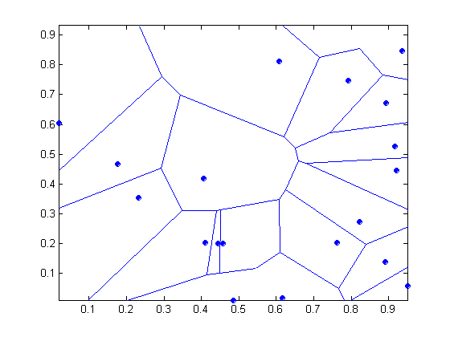
Nearest Neighbor Classifiers
Nearest neighbor classifiers are local classifiers
They can produce decision boundaries of arbitrary shapes.
1-nn decision boundary is a Voronoi Diagram

Slide 10
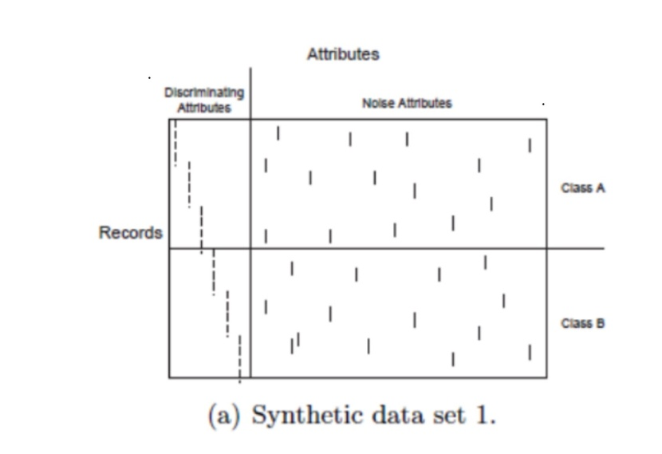
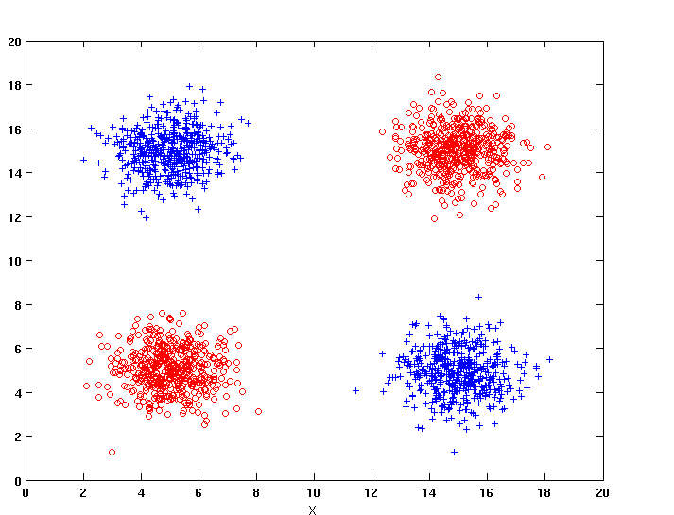
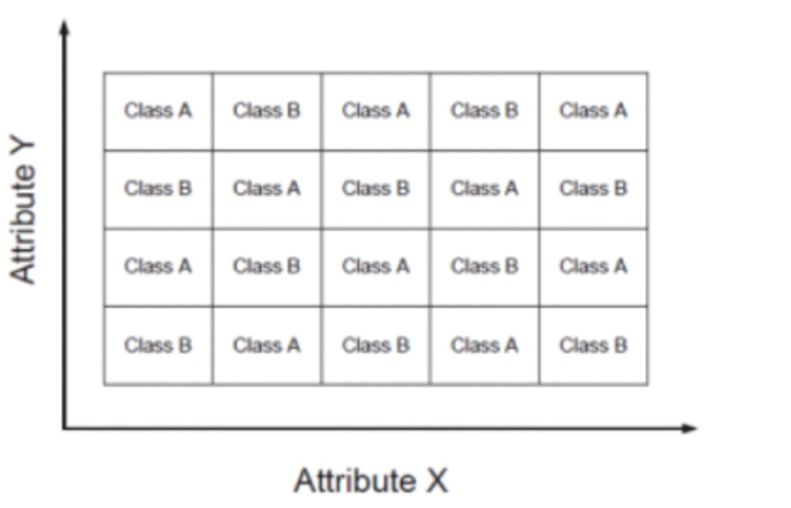
Nearest Neighbor Classifiers
How to handle missing values in training and test sets?
Proximity computations normally require the presence of all attributes
Some approaches use the subset of attributes present in two instances
This may not produce good results since it effectively uses different proximity measures for each pair of instances
Thus, proximities are not comparable
Irrelevant attributes add noise to the proximity measure
Redundant attributes bias the proximity measure towards certain attributes

Slide 11
Improving KNN Efficiency
Avoid having to compute distance to all objects in the training set
Multi-dimensional access methods (k-d trees)
Fast approximate similarity search
Locality Sensitive Hashing (LSH)
Condensing
Determine a smaller set of objects that give the same performance
Editing
Remove objects to improve efficiency

Slide 12
Thanks！
Notes:
工作新意图发现

